Slide 1

Project 2
League of legends predicting win rate with linear regression

Slide 2
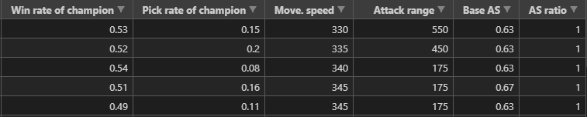
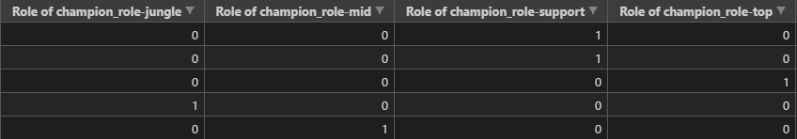
Data Cleaning
Selected variables from webscraped data and cleaned the data by:
Splitting roles into Boolean values
Changing percent to decimal values
Filling in null values
Changing type to floats
Dropping Jhin from the dataset (sorry Jhin…)

Slide 3
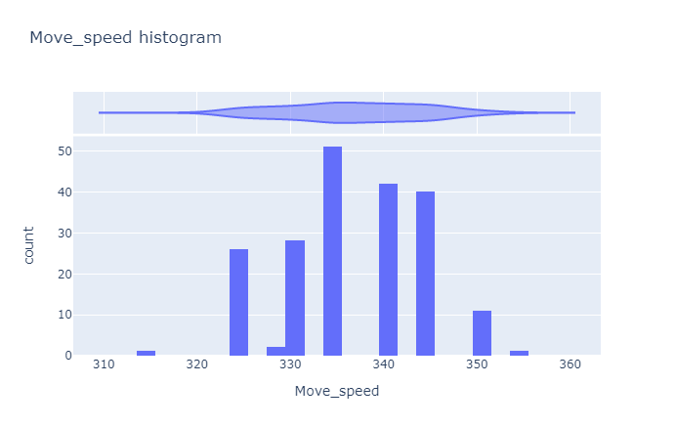
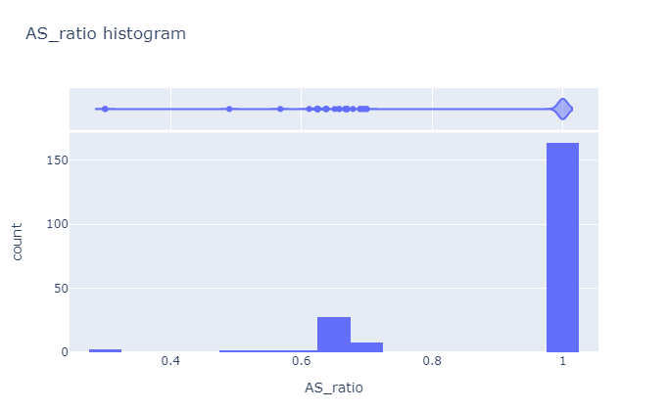
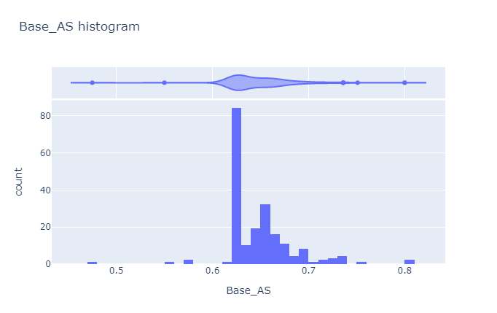
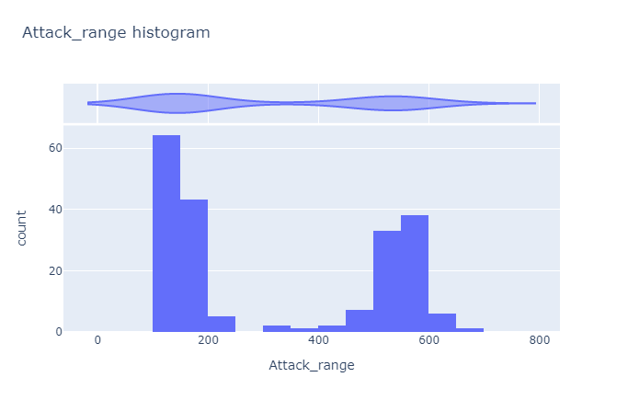
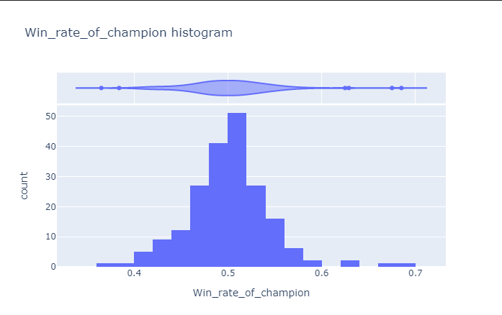
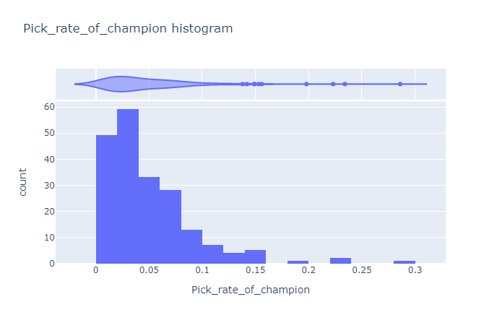
Histograms of non-categorical variables

Slide 4
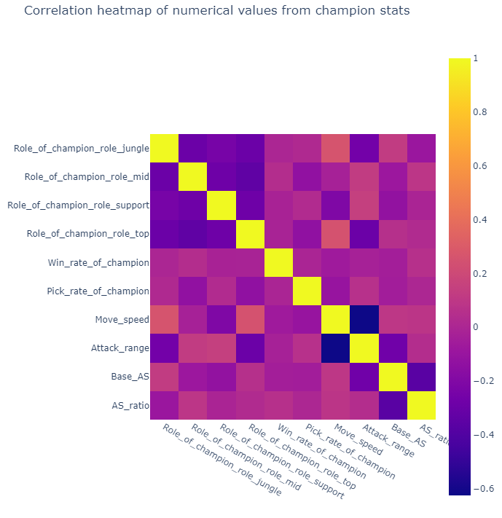
Heatmap of all variables

Slide 5
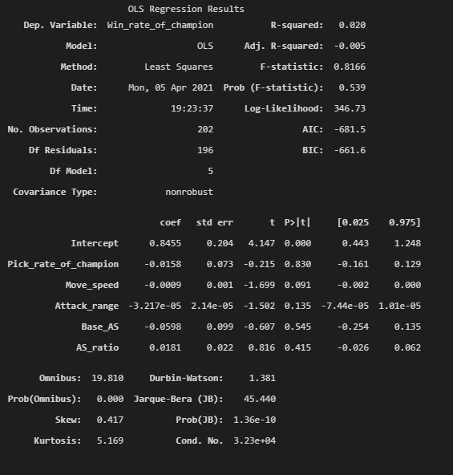
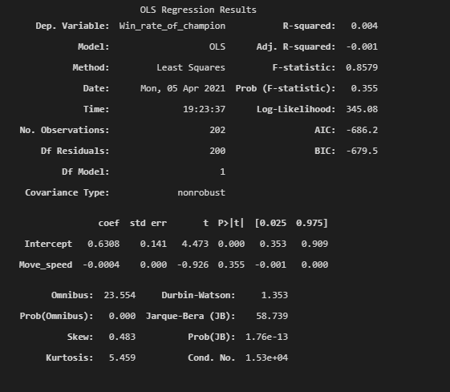
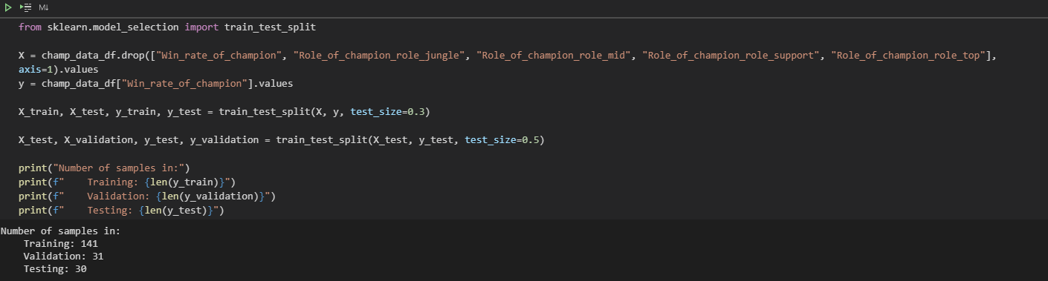
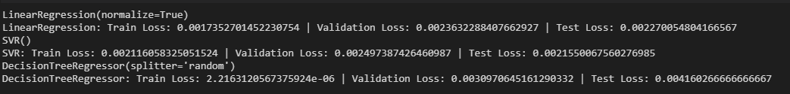
Baseline model, splitting and linear regression

Slide 6
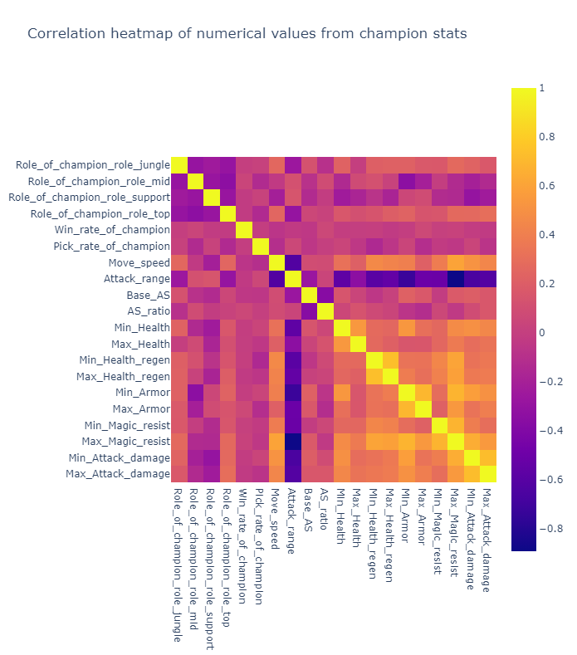
Heatmap with new variables

Slide 7
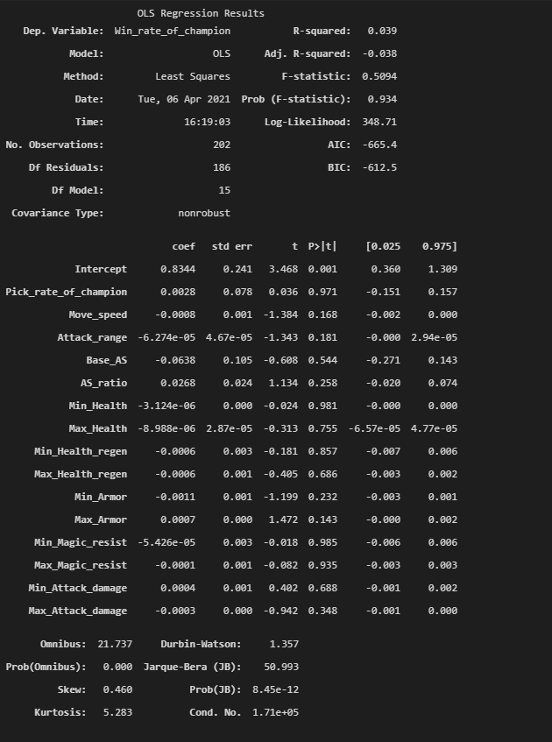
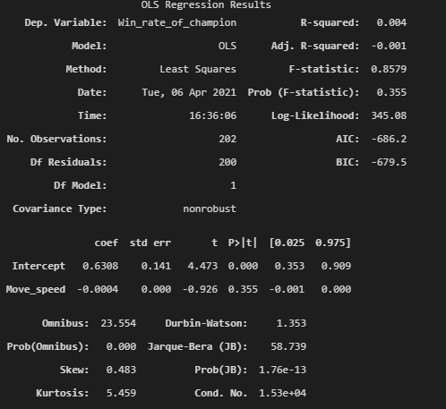
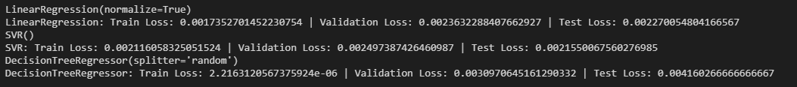
Baseline model, splitting and linear regression

Slide 8

Improvements
Add more variables
Find another model to pass variables on
See if you can measure player skill (elo)
Fix Jhin

